Slide 1
ZOO MANAGEMENT
SAKSHI SANCHETI b 207266
SUMAIYYA ANWAR B 207273
NIKITHA PUCHALA B 207256

Slide 2
Problem Statement:
To help for conservation of the Wildlife and to raise awareness amongst the future generation about the preservation of fauna, create a database for zoos. This database has information about animals present in zoo, employees who work and take care of animals at the zoo. Also, the databases has information about the visitors who visit zoo.

Slide 3
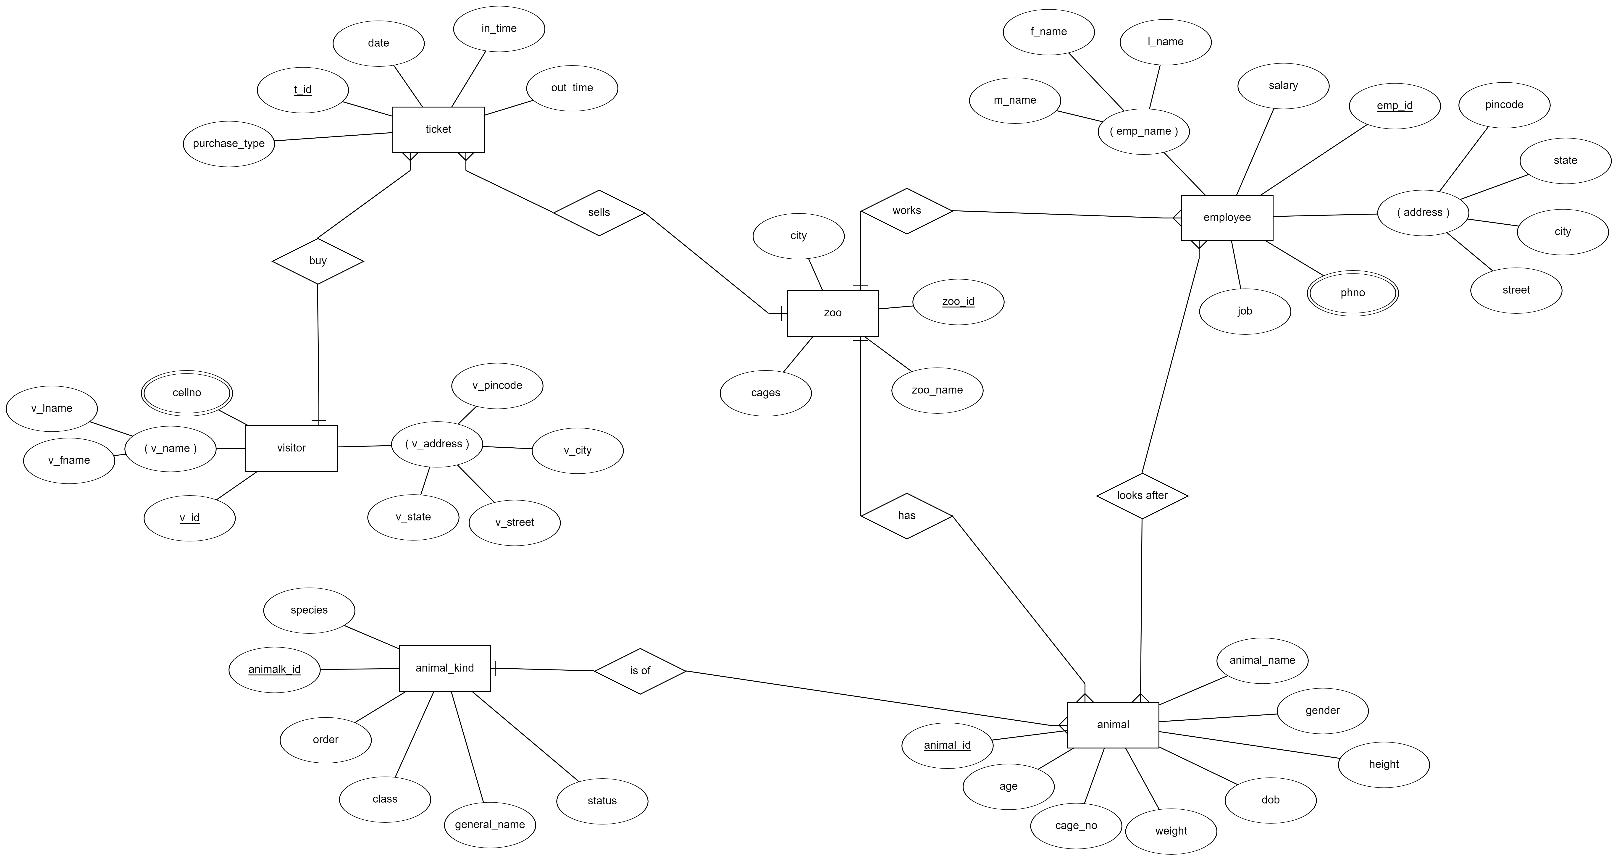
ER Diagram
ER DIAGRAM

Slide 4
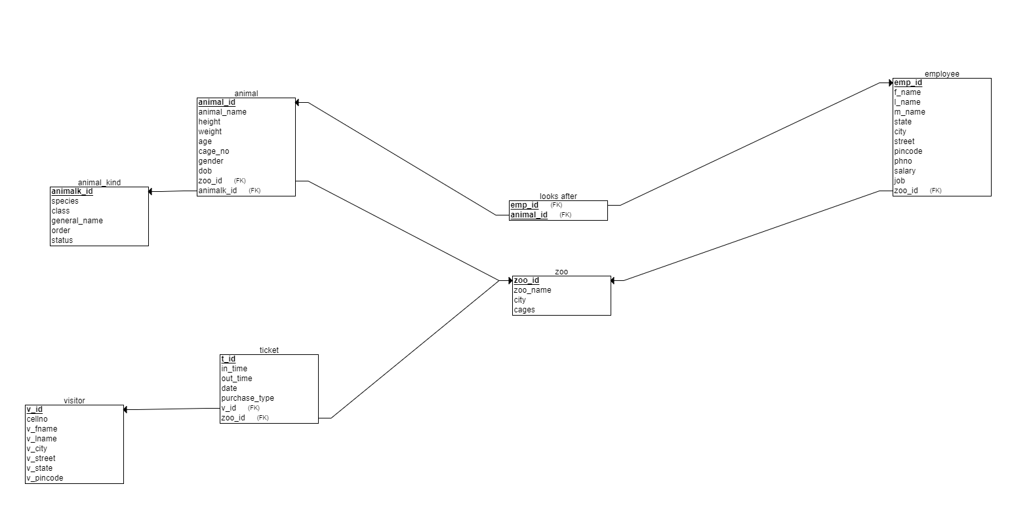
RELATIONAL SCHEMA

Slide 5
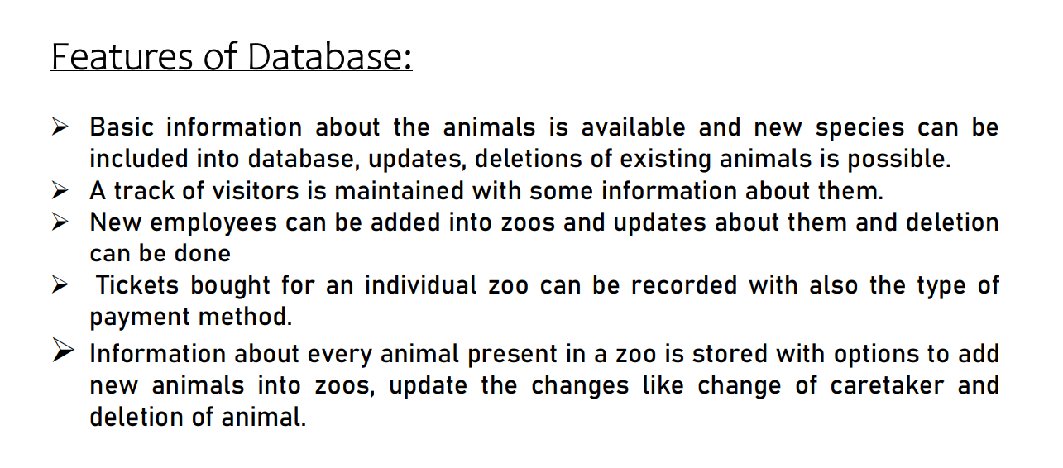

Slide 6
Normalisation

Slide 7
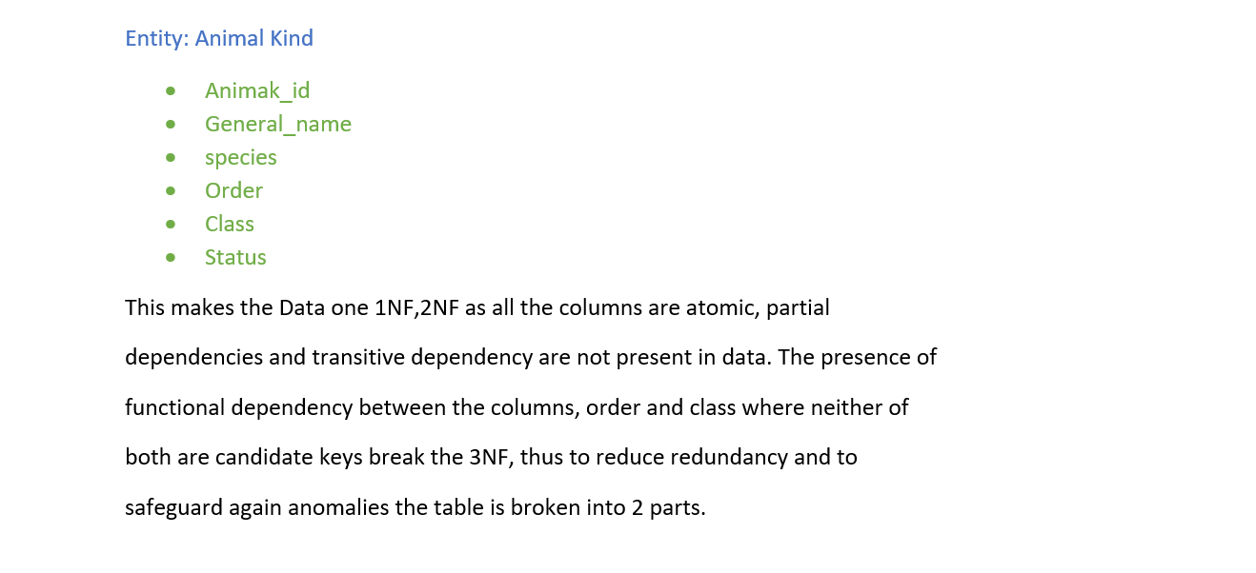
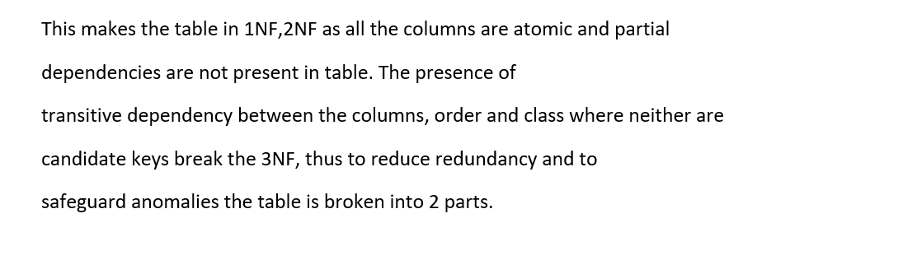

Slide 8
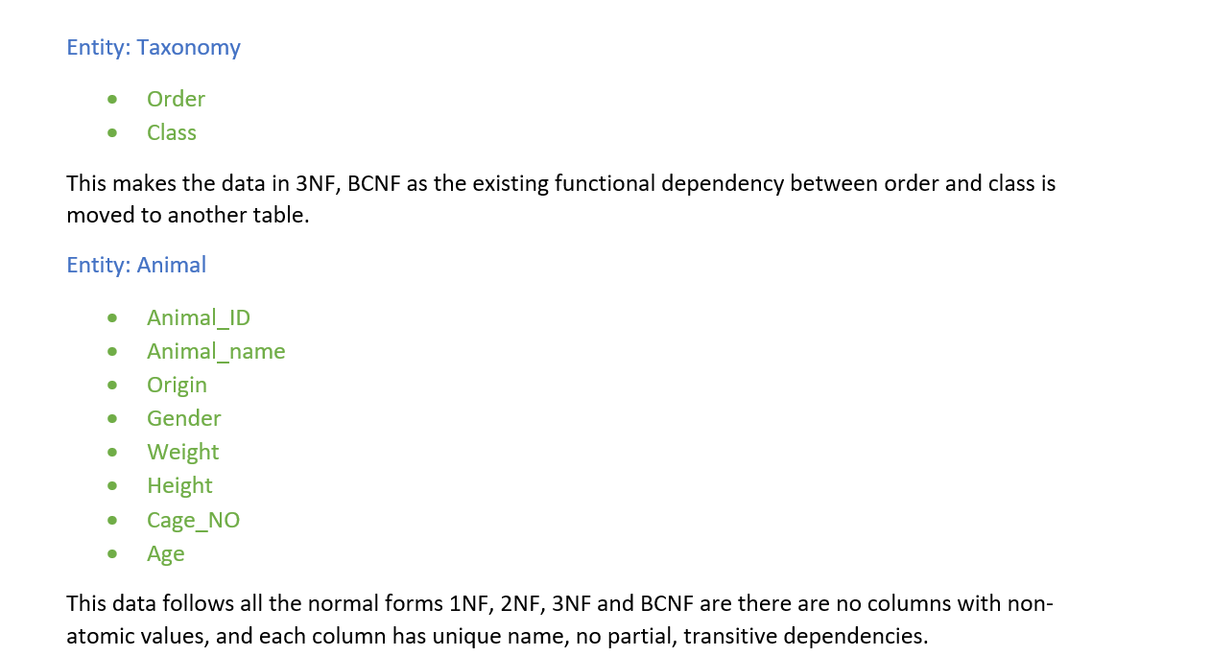

Slide 9
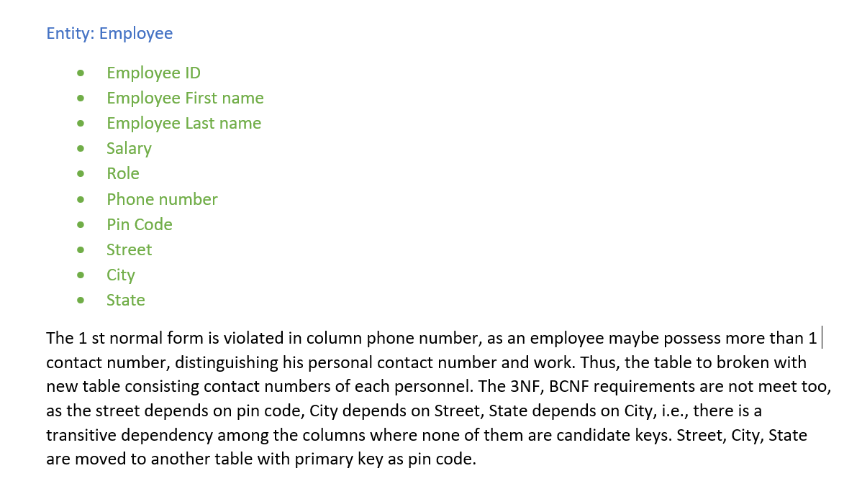
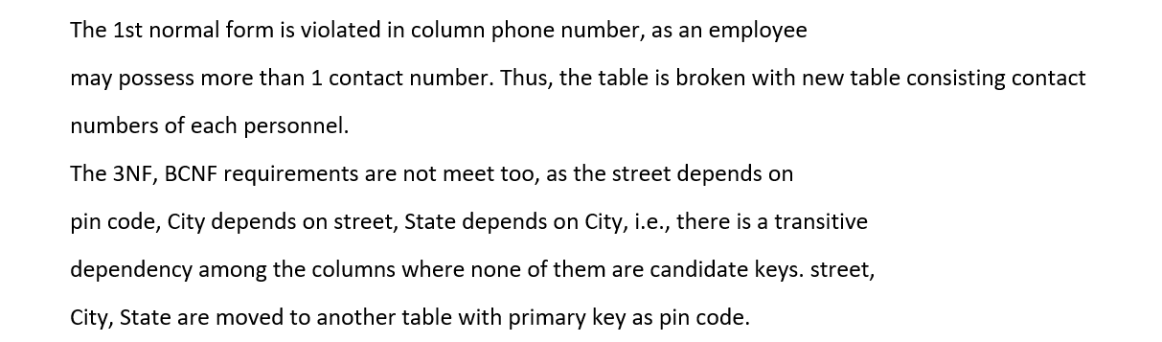

Slide 10
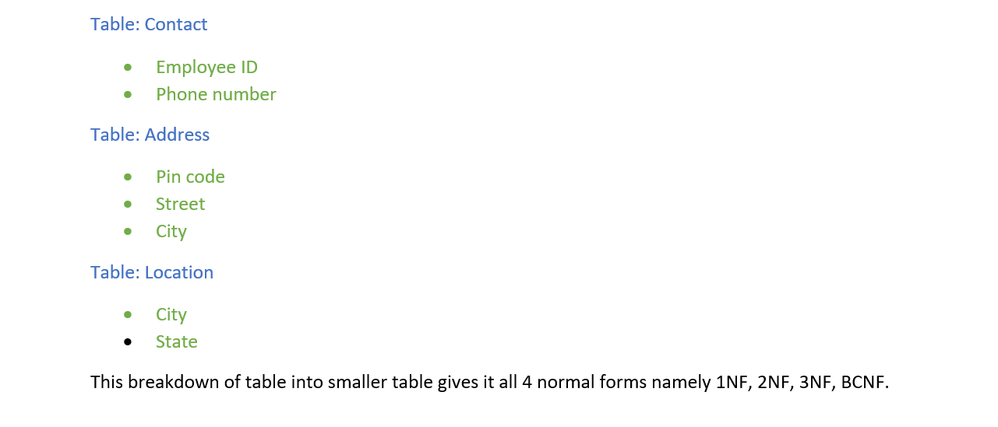


Slide 11
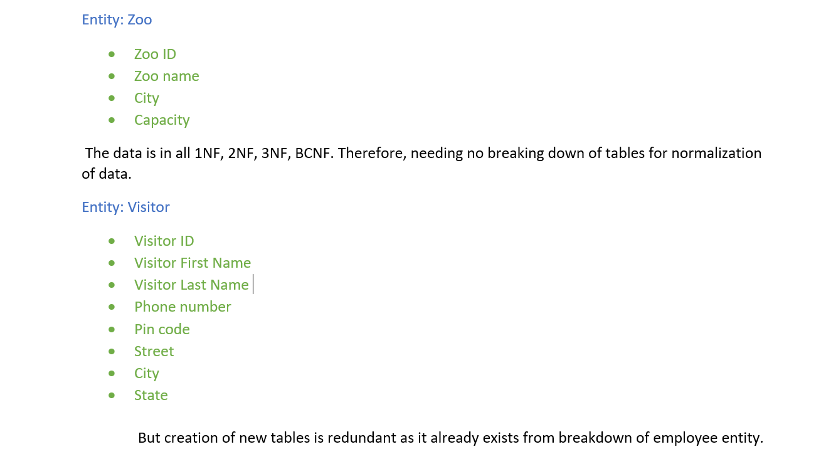


Slide 12
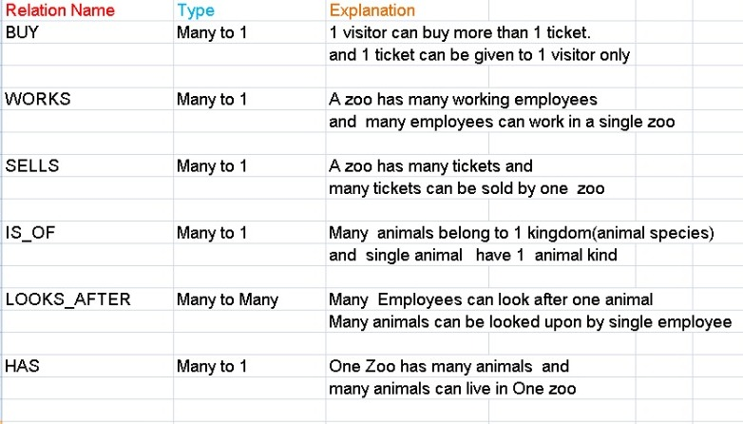

Slide 13
Relational schema after normalisation

Slide 14
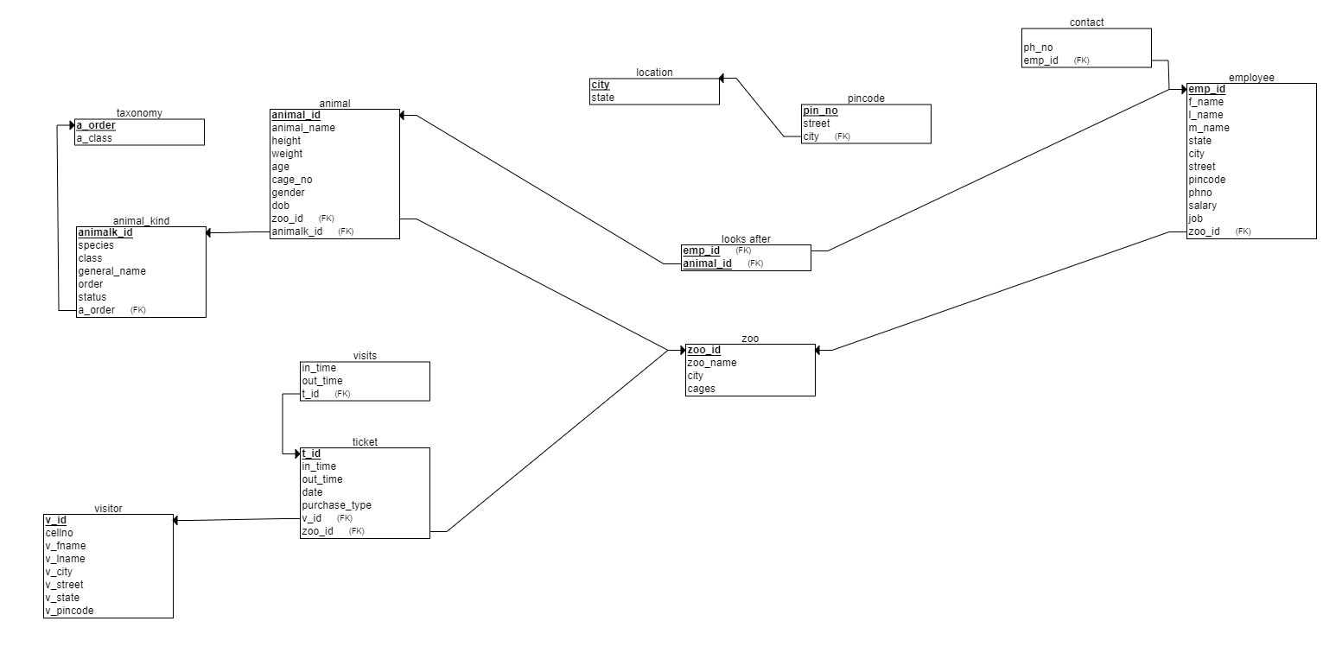

Slide 15
Creation of tables and insertion of data

Slide 16
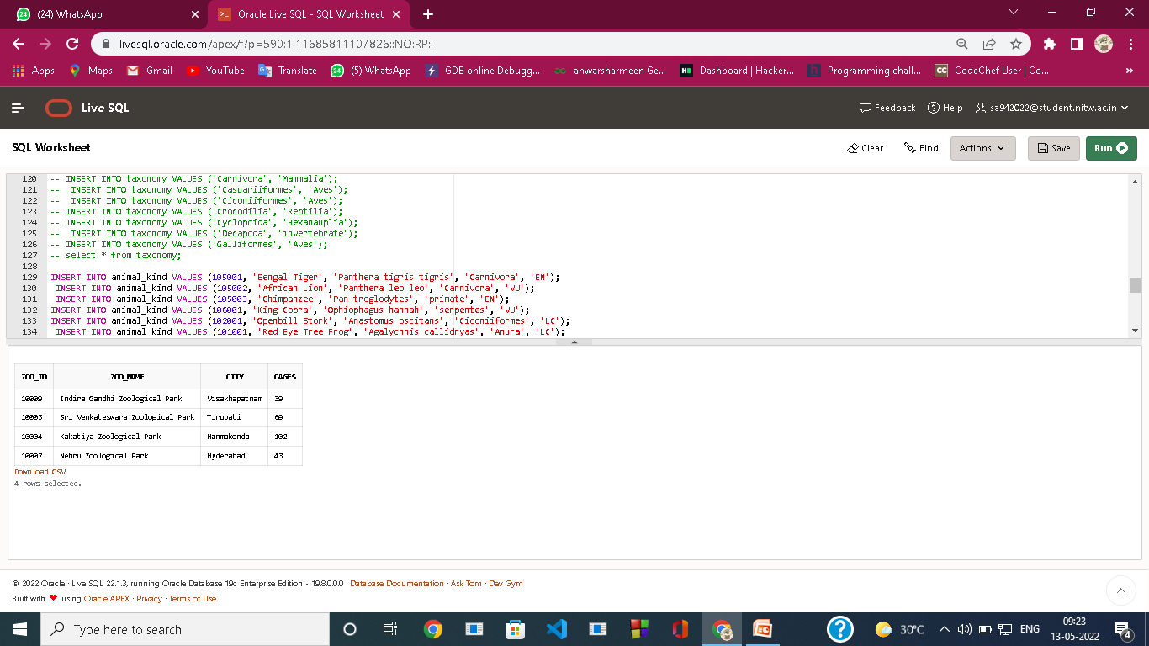
create table zoo
(
zoo_id number primary key,
zoo_name varchar(100),
city varchar(100),
cages number
);
INSERT INTO zoo VALUES (10003, 'Sri Venkateswara Zoological Park', 'Tirupati', 69);
INSERT INTO zoo VALUES (10004, 'Kakatiya Zoological Park', 'Hanmakonda', 102);
INSERT INTO zoo VALUES (10007, 'Nehru Zoological Park', 'Hyderabad', 43);
INSERT INTO zoo VALUES (10009, 'Indira Gandhi Zoological Park', 'Visakhapatnam',39);

Slide 17
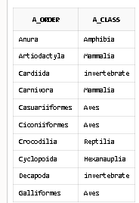
create table taxonomy(
a_order varchar(100) primary key,
a_class varchar(100)
);
INSERT INTO taxonomy VALUES ('Anura', 'Amphibia’);
INSERT INTO taxonomy VALUES ('Artiodactyla', 'Mammalia’);
INSERT INTO taxonomy VALUES ('Cardiida', 'invertebrate’);
INSERT INTO taxonomy VALUES ('Carnivora', 'Mammalia’);
INSERT INTO taxonomy VALUES ('Casuariiformes', 'Aves’);
INSERT INTO taxonomy VALUES ('Ciconiiformes', 'Aves’);
INSERT INTO taxonomy VALUES ('Crocodilia', 'Reptilia’);
INSERT INTO taxonomy VALUES ('Cyclopoida', 'Hexanauplia’);
INSERT INTO taxonomy VALUES ('Decapoda', 'invertebrate’);
INSERT INTO taxonomy VALUES ('Galliformes', 'Aves’);

Slide 18
create table animal_kind
(
animalk_id NUMBER primary key,
general_name varchar(100),
species varchar(100),
a_order varchar(100),
foreign key(a_order) references taxonomy(a_order),
status varchar(10)
);
INSERT INTO animal_kind VALUES (105001, 'Bengal Tiger', 'Panthera tigris tigris', 'Carnivora', 'EN’);
INSERT INTO animal_kind VALUES (105002, 'African Lion', 'Panthera leo leo', 'Carnivora', 'VU’);
INSERT INTO animal_kind VALUES (105003, 'Chimpanzee', 'Pan troglodytes', 'primate', 'EN’);
INSERT INTO animal_kind VALUES (106001, 'King Cobra', 'Ophiophagus hannah', 'serpentes', 'VU’);
INSERT INTO animal_kind VALUES (102001, 'Openbill Stork', 'Anastomus oscitans', 'Ciconiiformes', 'LC’);
INSERT INTO animal_kind VALUES (101001, 'Red Eye Tree Frog', 'Agalychnis callidryas', 'Anura', 'LC’);
INSERT INTO animal_kind VALUES (101002, 'Asiatic salamanders', 'Hynobius oyamai', 'Urodela', 'VU’);

Slide 19
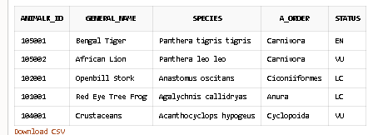
INSERT INTO animal_kind VALUES (103001, 'Lined Seahorse', 'Hippocampus erectus', 'Syngnathiformes', 'VU’);
INSERT INTO animal_kind VALUES (101003, 'Axolotl', 'Ambystoma mexicanum', 'Urodela', 'CR’);
INSERT INTO animal_kind VALUES (104001, 'Crustaceans', 'Acanthocyclops hypogeus', 'Cyclopoida', 'VU’);

Slide 20
Biological terms used in animal kind table
Officially, threatened species are those listed as Critically Endangered (CR), Endangered (EN) or Vulnerable (VU).
Practically this means:
Critically Endangered (CR): A species facing an extremely high risk of extinction in the wild.
Endangered (EN): A species considered to be facing a very high risk of extinction in the wild.
Vulnerable (VU): A species considered to be facing a high risk of extinction in the wild.

Slide 21
create table animal(
animal_id number primary key,
animal_name varchar(100),
cage_no number,
height number,
weight number,
age number,
gender varchar(10),
origin varchar(100),
animalk_id NUMBER,
FOREIGN KEY (animalk_id) REFERENCES animal_kind(animalk_id),
zoo_id number, FOREIGN KEY(zoo_id) REFERENCES zoo(zoo_id)
);

Slide 22
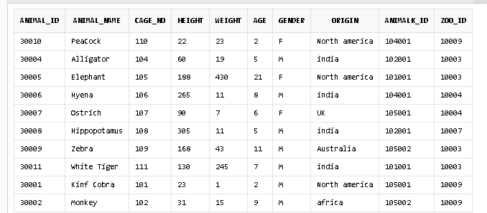
INSERT INTO animal VALUES (30001, ‘King Cobra', 101, 23, 1, 2, 'M', 'North america', 105001, 10009);
INSERT INTO animal VALUES (30002, 'Monkey', 102, 31, 15, 9, 'M', 'africa', 105002, 10009);
INSERT INTO animal VALUES (30004, 'Alligator', 104, 60, 19, 5, 'M ', 'india', 102001, 10003);
INSERT INTO animal VALUES (30005, 'Elephant', 105, 188, 430, 21, 'F', 'North america', 101001, 10003);
INSERT INTO animal VALUES (30006, 'Hyena', 106, 265, 11, 8, 'M', 'india', 104001, 10004);
INSERT INTO animal VALUES (30007, 'Ostrich', 107, 90, 7, 6, 'F', 'UK', 105001, 10004);
INSERT INTO animal VALUES (30008, 'Hippopotamus', 108, 305, 11, 5, 'M', 'india', 102001, 10007);
INSERT INTO animal VALUES (30009, 'Zebra', 109, 168, 43, 11, 'M', 'Australia', 105002, 10003);
INSERT INTO animal VALUES (30010, 'PeaCock', 110, 22, 23, 2, 'F', 'North america', 104001, 10009);
INSERT INTO animal VALUES (30011, 'White Tiger', 111, 130, 245, 7, 'M', 'india', 101001, 10003);

Slide 23
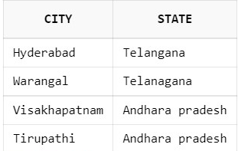
create table location(
city varchar(100) primary key,
state varchar(100));
INSERT INTO location VALUES ('Hyderabad', 'Telangana');
INSERT INTO location VALUES ('Warangal', 'Telanagana');
INSERT INTO location VALUES ('Visakhapatnam', 'Andharapradesh');
INSERT INTO location VALUES ('Tirupathi', 'Andhara pradesh');

Slide 24
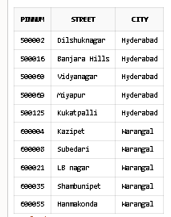
create table pincode( pinnum number primary key,
street varchar(100),
city varchar(100),
FOREIGN KEY (city) REFERENCES location(city));
INSERT INTO pincode VALUES (500002, 'Dilshuknagar', 'Hyderabad’);
INSERT INTO pincode VALUES (500016, 'Banjara Hills', 'Hyderabad’);
INSERT INTO pincode VALUES (500060, 'Vidyanagar', 'Hyderabad’);
INSERT INTO pincode VALUES (500069, 'Miyapur', 'Hyderabad’);
INSERT INTO pincode VALUES (500125, 'Kukatpalli', 'Hyderabad’);
INSERT INTO pincode VALUES (600004, 'Kazipet', 'Warangal’);
INSERT INTO pincode VALUES (600008, 'Subedari', 'Warangal’);
INSERT INTO pincode VALUES (600021, 'LB nagar', 'Warangal’);
INSERT INTO pincode VALUES (600035, 'Shambunipet', 'Warangal’);
INSERT INTO pincode VALUES (600055, 'Hanmakonda', 'Warangal');

Slide 25
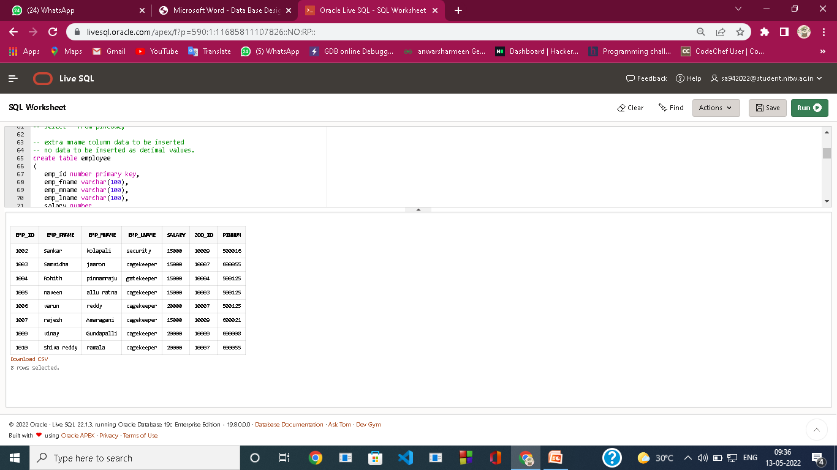
create table employee ( emp_id number primary key, emp_fname varchar(100), emp_mname varchar(100), emp_lname varchar(100), salary number, zoo_id number, FOREIGN KEY (zoo_id)REFERENCES zoo(zoo_id), pinnum number, foreign key (pinnum) REFERENCES pincode(pinnum) ); INSERT INTO employee VALUES (1001, 'Raghu', 'Phanesh', 'sanitary', 60000, 10004, 500001); INSERT INTO employee VALUES (1002, 'Sankar', 'kolapali', 'security', 15000, 10009,500016); INSERT INTO employee VALUES (1003, 'Samvidha', 'jaaron', 'cagekeeper', 15000, 10007, 600055); INSERT INTO employee VALUES (1004, 'Rohith', 'pinnamraju', 'gatekeeper', 15000, 10004, 500125); INSERT INTO employee VALUES (1005, 'naveen', 'allu ratna', 'cagekeeper', 15000, 10003, 500125); INSERT INTO employee VALUES (1006, 'varun', 'reddy', 'cagekeeper', 20000, 10007, 500125); INSERT INTO employee VALUES (1007, 'rajesh', 'Amaragani', 'cagekeeper', 15000, 10009, 600021); INSERT INTO employee VALUES (1008, 'Waseem', 'Agarwal', 'cagekeeper', 15000, 10003, 500001); INSERT INTO employee VALUES (1009, 'vinay ', 'Gundapalli', 'cagekeeper', 20000, 10009, 600008); INSERT INTO employee VALUES (1010, 'shiva reddy', 'ramala', 'cagekeeper', 20000, 10007, 600055);

Slide 26
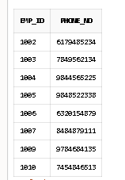
create table contact(
emp_id number,
FOREIGN KEY (emp_id) REFERENCES employee(emp_id), phone_no number);
INSERT INTO contact VALUES (1001, 8741122565);
INSERT INTO contact VALUES (1002, 6179485234);
INSERT INTO contact VALUES (1003, 7849562134);
INSERT INTO contact VALUES (1004, 9844565225);
INSERT INTO contact VALUES (1005, 9848522338);
INSERT INTO contact VALUES (1006, 6320154879);
INSERT INTO contact VALUES (1007, 8484879111);
INSERT INTO contact VALUES (1008, 9787488845);
INSERT INTO contact VALUES (1009, 9784684135);
INSERT INTO contact VALUES (1010, 7454846513);

Slide 27
create table visitor( v_id number PRIMARY KEY,
phone_no number,
pinnum number, foreign key (pinnum) references pincode(pinnum),
v_fname varchar(100),
v_lname varchar(100)
);
INSERT INTO visitor VALUES (1000002, 8247423616, 500001, 'Sandhya', 'Dhanavath’);
INSERT INTO visitor VALUES (1000003, 9848522338, 500002, 'Shankar', 'Tejavath’);
INSERT INTO visitor VALUES (1000004, 7532148967, 500060, 'Waseem', 'Syed’ );
INSERT INTO visitor VALUES (1000005, 6459783120, 500125, 'Manoj', 'Boganadham’);
INSERT INTO visitor VALUES (1000006, 8524615397, 500069, 'Infi', 'Chan’);
INSERT INTO visitor VALUES (1000007, 9754125896, 600004, 'Bhushank', 'Kul’);
INSERT INTO visitor VALUES (1000008, 8462157930, 600055, 'Abhiram', 'Nallama’);
INSERT INTO visitor VALUES (1000009, 6841759325, 600008, 'Ashish', 'Anand’);
INSERT INTO visitor VALUES (1000010, 8945632178, 600154, 'Lakshita', 'Chowdary’);
INSERT INTO visitor VALUES (1000011, 9685741232, 600035, 'Nayan', 'Jyothi’);
INSERT INTO visitor VALUES (1000012, 8675941236, 600021, 'Ranil', 'Bala’);
INSERT INTO visitor VALUES (1000013, 7849562134, 600154, 'Tanisha', 'Agarwal');

Slide 28
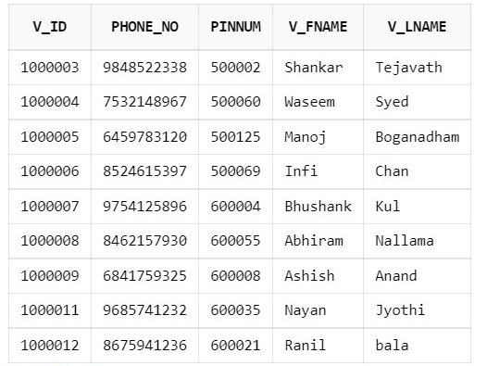

Slide 29
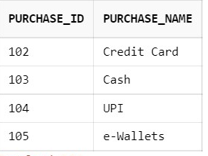
create table purchase(
purchase_id number primary key, purchase_name varchar(100));
insert into purchase values(102,'Credit Card');
insert into purchase values(103,'Cash');
insert into purchase values(104,'UPI');
insert into purchase values(105,'e-wallets');

Slide 30
create table ticket(
ticket_id number primary key,
ticket_date date,
v_id number,
FOREIGN KEY (v_id) REFERENCES visitor(v_id),
purchase_id number,
FOREIGN KEY (purchase_id) REFERENCES purchase(purchase_id),
zoo_id number, FOREIGN KEY (zoo_id) REFERENCES zoo(zoo_id));
INSERT INTO ticket VALUES (9034351, '15-08-2020', 1000002, 104, 10004);
INSERT INTO ticket VALUES (2110003, '15-02-2020', 1000003, 104, 10007);I
NSERT INTO ticket VALUES (6382682, '15-02-2020', 1000004, 103, 10003);I
NSERT INTO ticket VALUES (6824217, '14-02-2020', 1000005, 102, 10007);
INSERT INTO ticket VALUES (5193139, '15-02-2020', 1000006, 103, 10009);
INSERT INTO ticket VALUES (5542291, '14-02-2020', 1000007, 102, 10003);
INSERT INTO ticket VALUES (2580752, '14-02-2020', 1000008, 104, 10007);
INSERT INTO ticket VALUES (9154961, '15-02-2020', 1000009, 102, 10007);
INSERT INTO ticket VALUES (8391607, '14-02-2020', 1000010, 101, 10007);
INSERT INTO ticket VALUES (1329791, '14-02-2020', 1000011, 102, 10007);

Slide 31
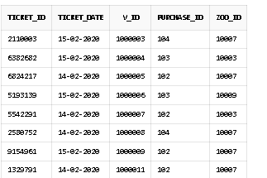

Slide 32
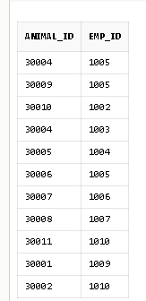
create table looks_after(
animal_id number,
FOREIGN kEY (animal_id) REFERENCES animal(animal_id), emp_id number,
FOREIGN KEY (emp_id) REFERENCES employee(emp_id));
INSERT INTO looks_after(animal_id, emp_id) VALUES (30010, 1002);
INSERT INTO looks_after(animal_id, emp_id) VALUES (30004, 1003);
INSERT INTO looks_after(animal_id, emp_id) VALUES (30005, 1004);
INSERT INTO looks_after(animal_id, emp_id) VALUES (30006, 1005);
INSERT INTO looks_after(animal_id, emp_id) VALUES (30007, 1006);
INSERT INTO looks_after(animal_id, emp_id) VALUES (30008, 1007);
INSERT INTO looks_after(animal_id, emp_id) VALUES (30009, 1000);
INSERT INTO looks_after(animal_id, emp_id) VALUES (30011, 1010);
INSERT INTO looks_after(animal_id, emp_id) VALUES (30001, 1009);
INSERT INTO looks_after(animal_id, emp_id) VALUES (30002, 1010);

Slide 33
create table visits(
ticket_id number PRIMARY KEY,
FOREIGN KEY (ticket_id) REFERENCES ticket(ticket_id), in_time TIMESTAMP,
out_time TIMESTAMP);
INSERT INTO visits VALUES (1329791, to_timestamp('16/02/2020 10:53:10', 'dd/mm/yyyy HH24:MI:SS'),to_timestamp( '16/02/2020 16:53:15','dd/mm/yyyy HH24:MI:SS'));INSERT INTO visits VALUES (9154961, to_timestamp('2020-02-16 10:53:45','yyyy/mm/dd HH24:MI:SS'), to_timestamp('2020-02-16 16:07:41','yyyy/mm/dd HH24:MI:SS'));INSERT INTO visits VALUES (5542291, TO_TIMESTAMP('2020/02/16 10:45:55','yyyy/mm/dd HH24:MI:SS'), TO_TIMESTAMP('2020/02/16 16:05:09','yyyy/mm/dd HH24:MI:SS'));INSERT INTO visits VALUES (5193139, TO_TIMESTAMP('2020/02/16 10:57:30','yyyy/mm/dd HH24:MI:SS'), TO_TIMESTAMP('2020/02/16 16:07:11','yyyy/mm/dd HH24:MI:SS'));INSERT INTO visits VALUES (6824217, TO_TIMESTAMP('2020/02/16 10:59:37','yyyy/mm/dd HH24:MI:SS'), TO_TIMESTAMP('2020/02/16 16:49:04','yyyy/mm/dd HH24:MI:SS'));INSERT INTO visits VALUES (2110003, TO_TIMESTAMP('2020/02/16 10:35:55','yyyy/mm/dd HH24:MI:SS'), TO_TIMESTAMP('2020/02/16 16:39:35','yyyy/mm/dd HH24:MI:SS'));INSERT INTO visits VALUES (6382682, TO_TIMESTAMP('2020/02/16 10:19:33','yyyy/mm/dd HH24:MI:SS'), TO_TIMESTAMP('2020/02/16 16:37:00','yyyy/mm/dd HH24:MI:SS'));

Slide 34
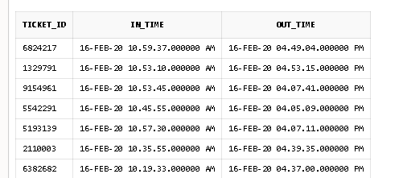

Slide 35


Slide 36
Thank you

